Slide 1

SPCH 275
DeVry University
By Glannie Bongcaron, Christopher Iwen, Charlene Naputi, Christopher Patterson

Slide 2
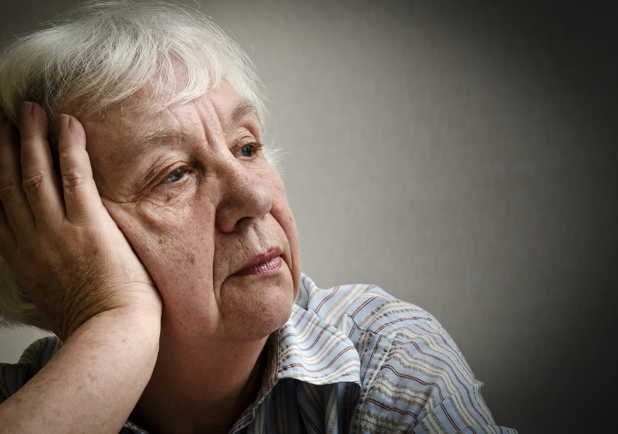

Slide 3
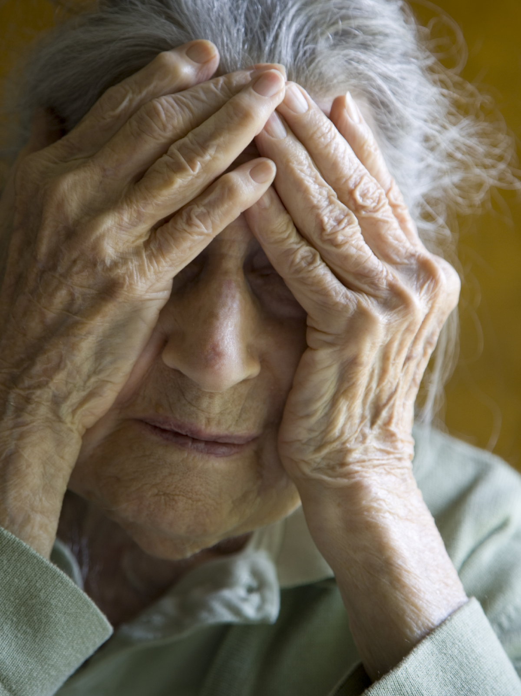
Dangers
Exploitation
Over Medication
Abuse
Neglect
Death

Slide 4
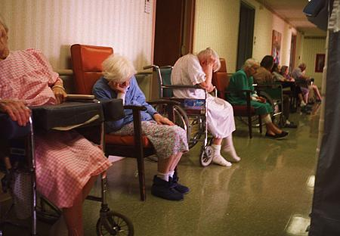

Slide 5


Slide 6


Slide 7


Slide 8
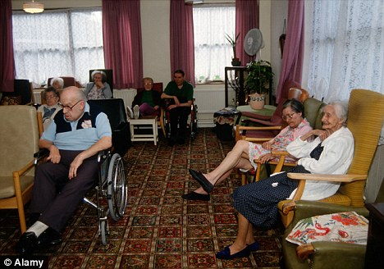

Slide 9

elder abuse is underreported
no official national statistics on how many older people are mistreated physically, emotionally or financially

Slide 10
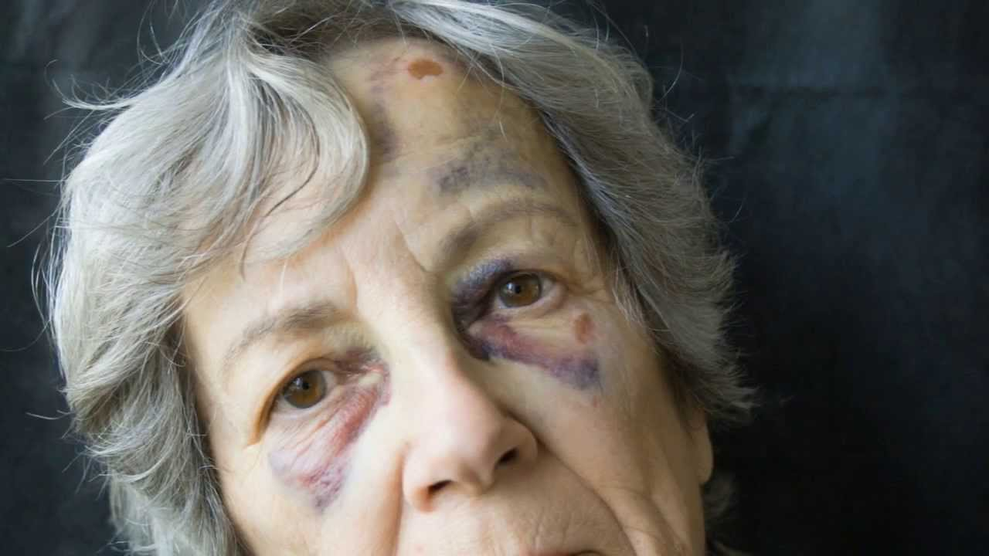

Slide 11
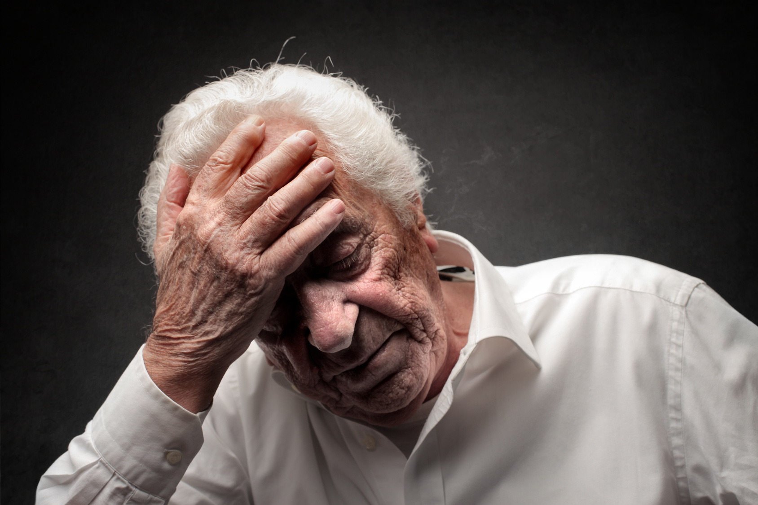

Slide 12
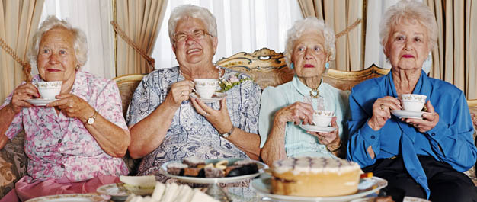

Slide 13

“Independent-living situations often
prolong an active lifestyle and
push back the need for assisted
living by several years” (Martin, 2015)

Slide 14

“Independent-living options offer more
opportunities to maintain an active
lifestyle than when the aging parents
stay in their own home” (Martin, 2015)

Slide 15


Slide 16


Slide 17
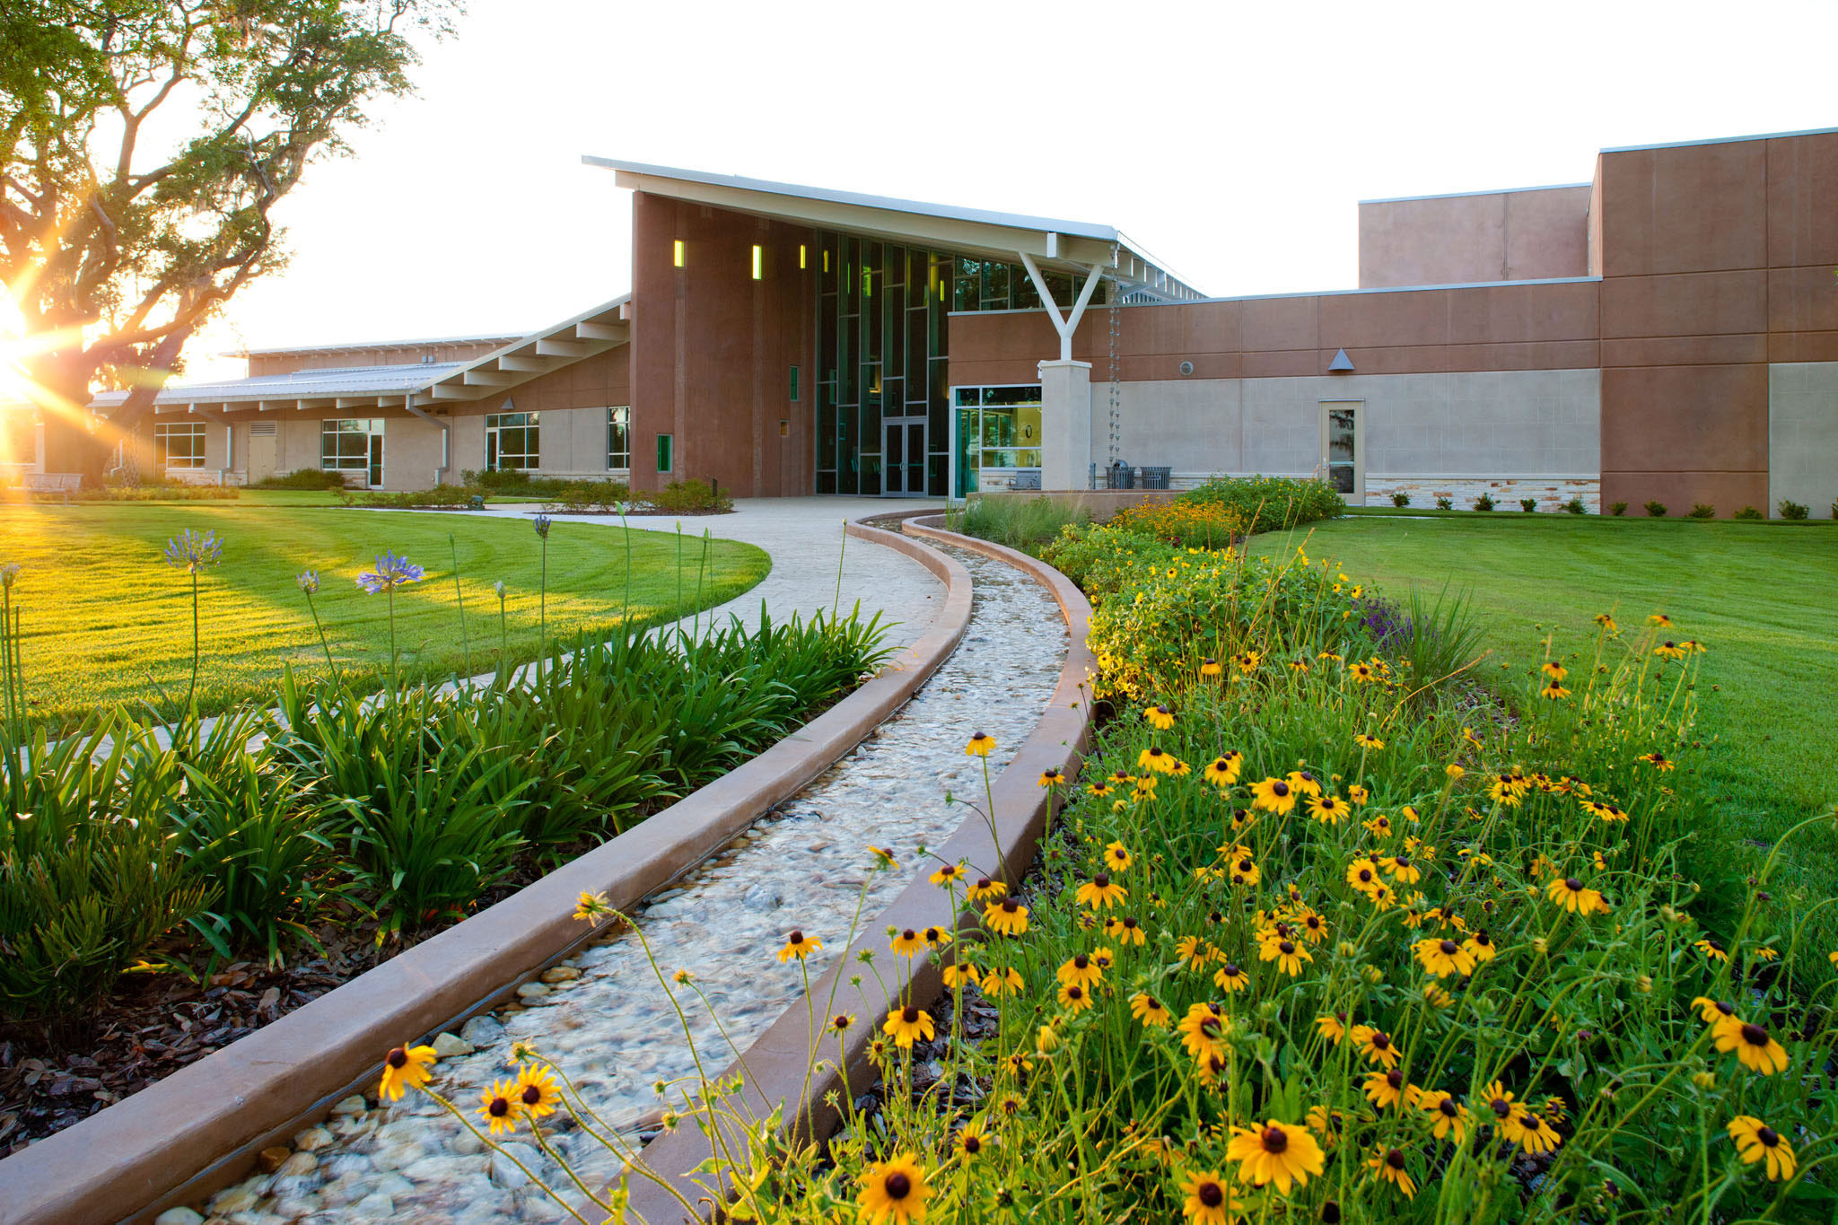

Slide 18


Slide 19
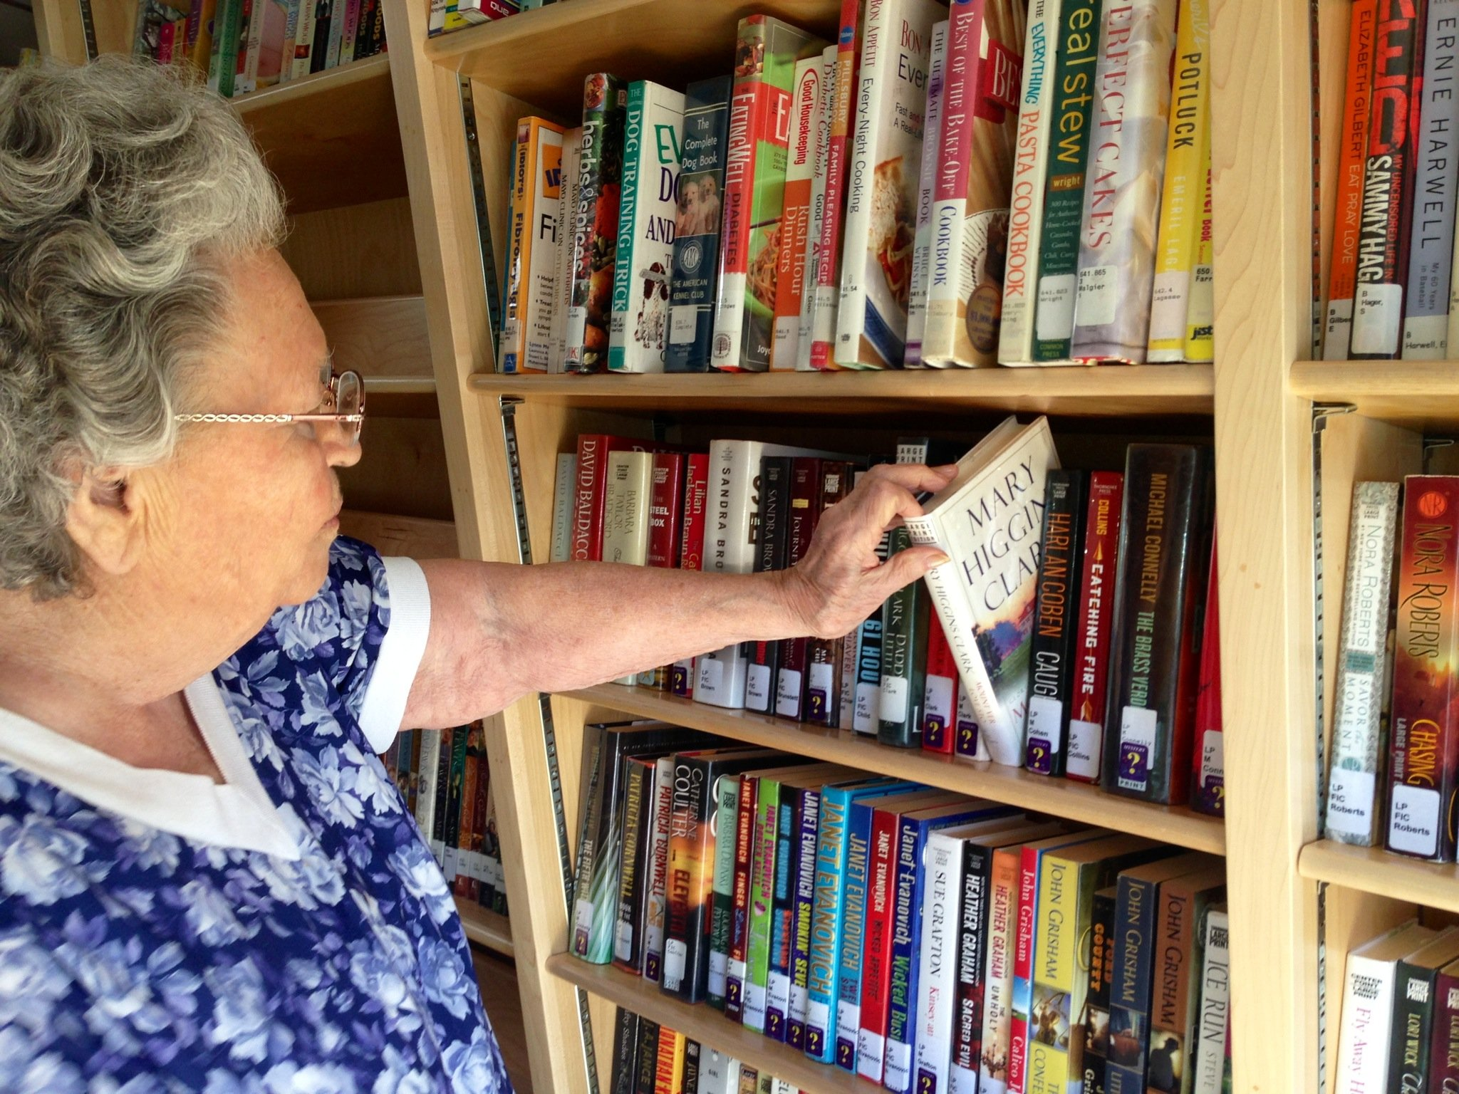

Slide 20


Slide 21


Slide 22
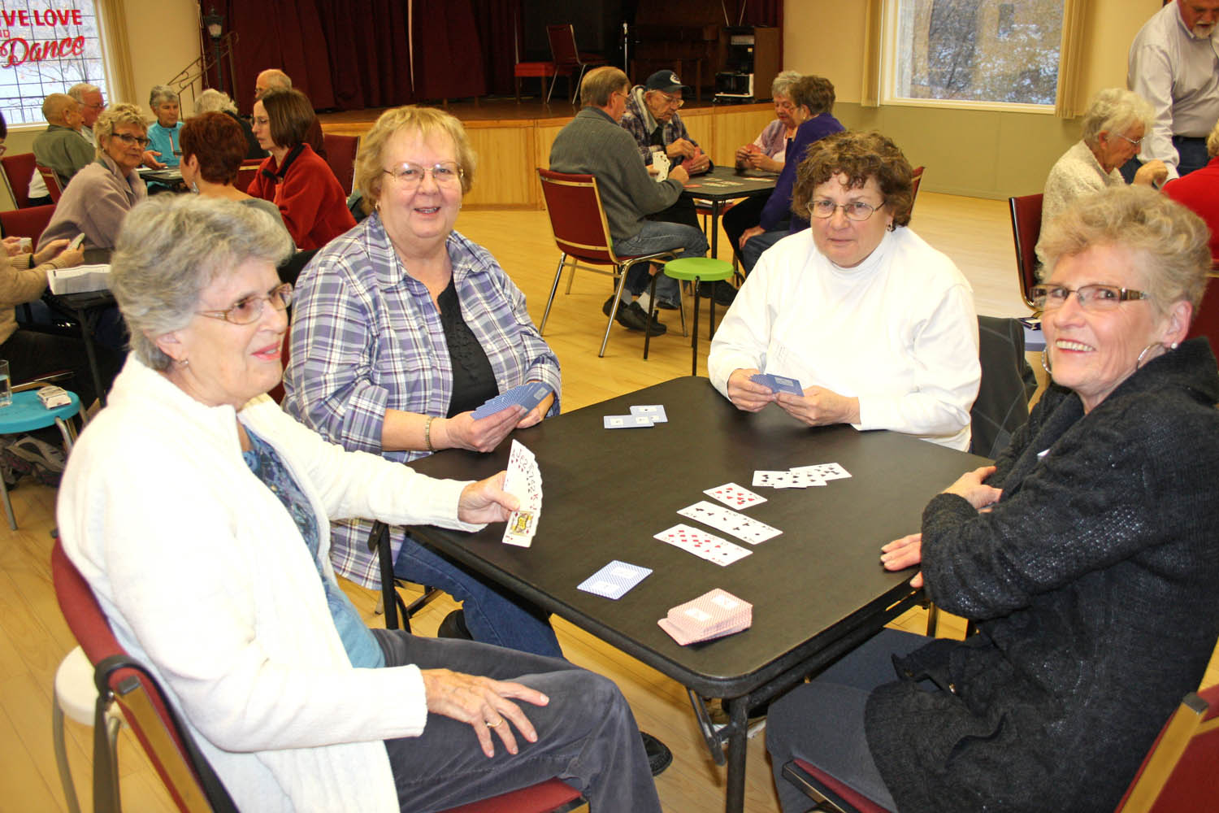

Slide 23


Slide 24


Slide 25


Slide 26


Slide 27
References
Beamish, R. (2015, May 26). Elder Abuse a 'Huge, Expensive and Lethal' Problem for States. Stateline.org (Washington, DC).
Martin, T. (2015). Let's Talk. Indianapolis Monthly. Oct2015, p98-103. 4p. ., 98-103. Retrieved from EBSCO Host database. (Accession No. 109455439)

